Slide 1
Dimensionality Reduction
By Yaohang Li, Ph.D. Department of Computer Science Old Dominion University yaohang@cs.odu.edu

Slide 2
Agenda
Introduction to Dimension Reduction
Dimension Reduction Methods
Linear Methods
Principle Component Analysis
Linear Discriminative Analysis
Nonlinear Methods
Kernel PCA
Kernel LDA
ISOMAP
Autoencoder
Applications of Dimension Reduction

Slide 3
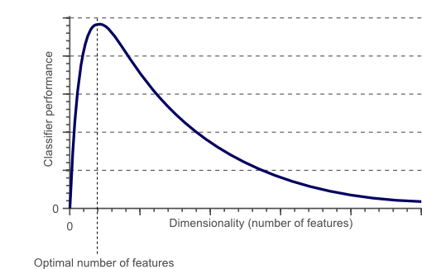
Motivation of Dimensionality Reduction
Dilemma of More Features
Pros
More information
Potentially higher accuracy
Cons
Harder to extract useful information
Harder to train a machine learning model
Dimensionality Reduction
Reduce the number of features (dimensionality)
But preserve the important properties

Slide 4
Dimensionality Reduction
Reduce the number of columns

Slide 5
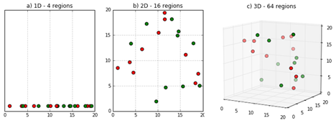
The Curse of Dimensionality
Sparsity of data in high dimensions
The volume of space grows exponentially as dimensionality increases
The data cannot keep up
Data become scarce in each region

Slide 6

Curse of Dimensionality (cont.)
Closeness of Data
Data are more likely located at the corners of the feature space
How many corners?
Data at different corners seem very different
?
d = 2, corners = 4
d = 3, corners = 8
d = 7, corners = 128
d = 100, corners = 2¹⁰⁰

Slide 7
Why Dimension Reduction?
Insight
Discover true underlying variables
Visualization
Projection of high-dimensional data points onto 2D or 3D space
Data Compression
Efficient Storage and Retrieval
Denoising
Remove Noise

Slide 8
Observed Dimensionality vs. True Dimensionality
Data points of a house
X1: Sale price
X2: Number of bedrooms
X3: Number of bathrooms
X4: Electricity bill
X5: Property tax
Data points of geographic areas
X1: # of skidding accidents
X2: # of burst water pipes
X3: Snow-plow expenditures
X4: # of school closures
X5: # of patients with heat stroke
House size?
Temperature?

Slide 9
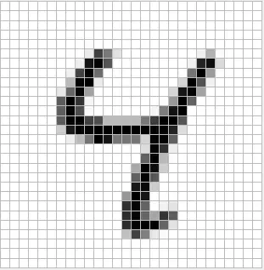
Observed Dimensionality vs. True Dimensionality
28x28 = 784 pixels (Observed Dimensionality)
True Dimensionality

Slide 10
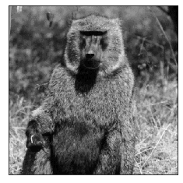
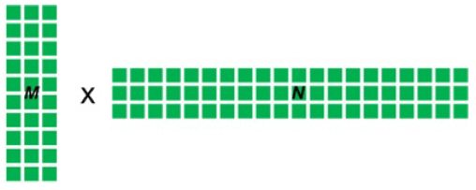
Demo: Dimension Reduction
jupyter notebook DimensionReduction.ipynb

Slide 11
Agenda
Introduction to Dimension Reduction
Dimension Reduction Methods
Linear Methods
Principle Component Analysis
Linear Discriminative Analysis
Nonlinear Methods
Kernel PCA
Kernel LDA
ISOMAP
Autoencoder
Applications of Dimension Reduction

Slide 12
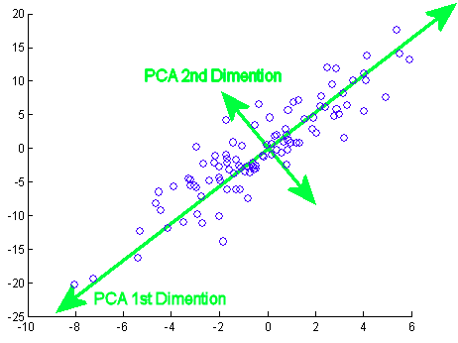
Principle Component Analysis (PCA)
Principle Component Analysis
Rationale
Find principle components that capture the maximal variance within the data
Unsupervised Learning
Linear transform
Extract hidden low-dimensional structure from high dimensional datasets
Maintain as much as possible of the variation presented in the original dataset

Slide 13
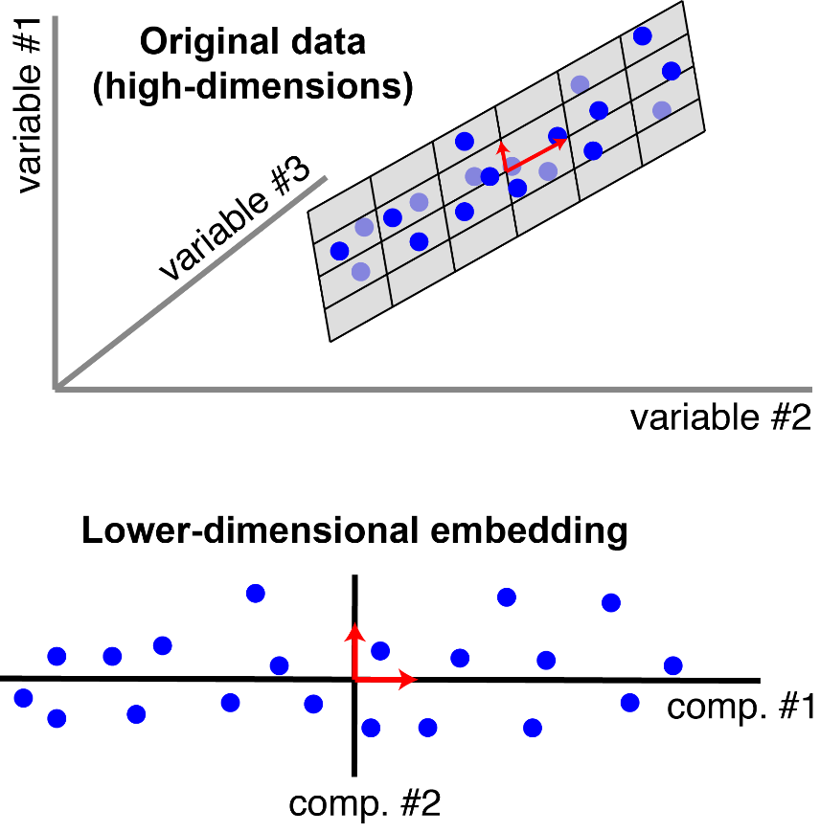
The View of Principle Components
Each blue point corresponds to a row in the dataset (an observation). There are 20 observations, each with 3 features (3 dimensions). PCA reduces the dimensionality from 3 to 2. It finds a pair of orthogonal vectors that define a lower-dimensional space which captures as much variance as possible from the original dataset.
Everything you did and didn't know about PCA, Alex Williams

Slide 14
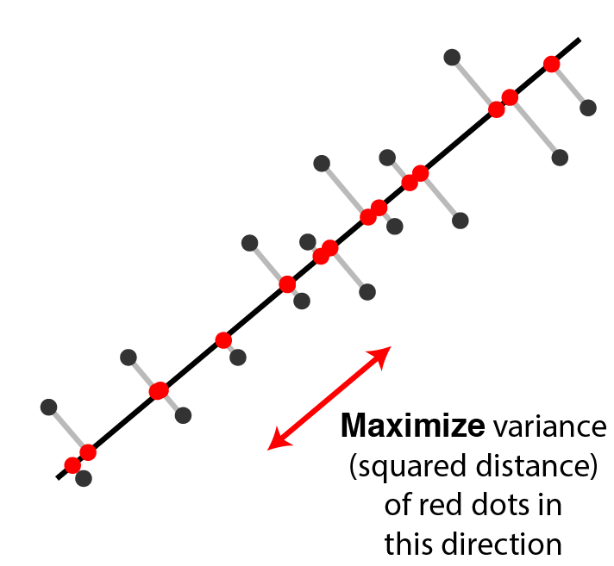
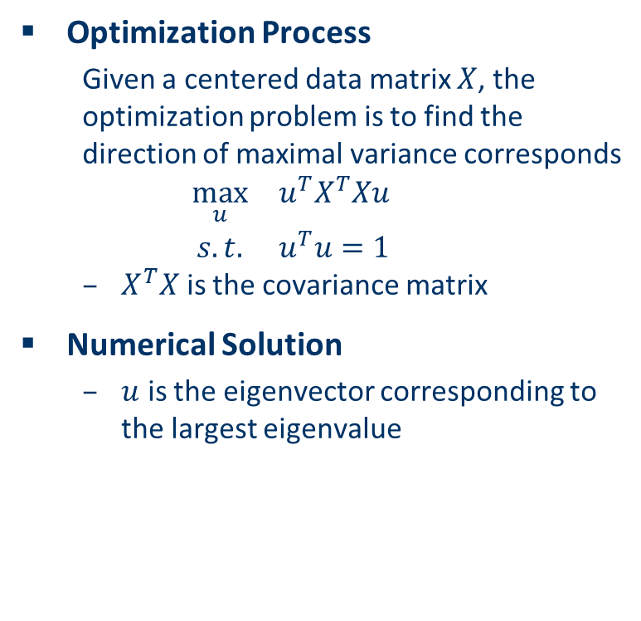
Computation of PCA
Optimization Process
Given a centered data matrix $X$, the optimization problem is to find the direction of maximal variance corresponds
$$\begin{matrix}\max_{u} & u^{T}X^{T}Xu \\ s.t. & u^{T}u=1\end{matrix}$$
$X^{T}X$ is the covariance matrix
Numerical Solution
$u$ is the eigenvector corresponding to the largest eigenvalue
Everything you did and didn't know about PCA, Alex Williams

Slide 15
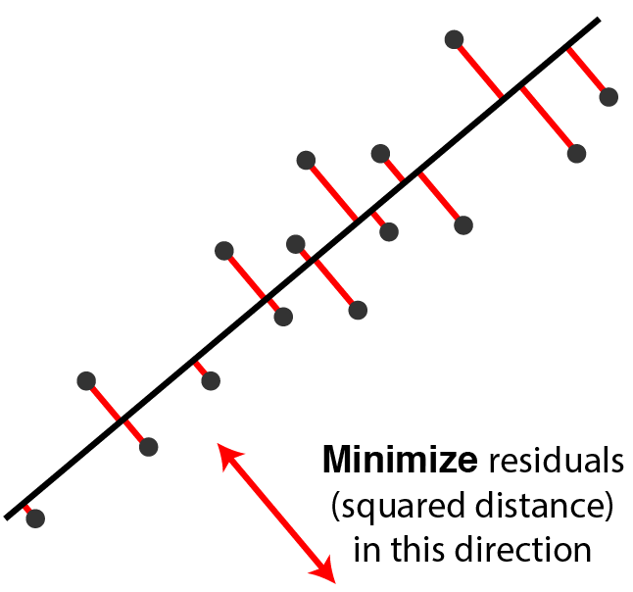

Alternative Computation of PCA
Optimization Process
Given a centered data matrix $X$, the optimization problem is to find the top $r$ principle components
$$\begin{matrix}\underset{U}{minimize} & {\left\|X−XUU^{T}\right\|}_{F}^{2} \\ s.t. & U^{T}U=1\end{matrix}$$
Everything you did and didn't know about PCA, Alex Williams

Slide 16
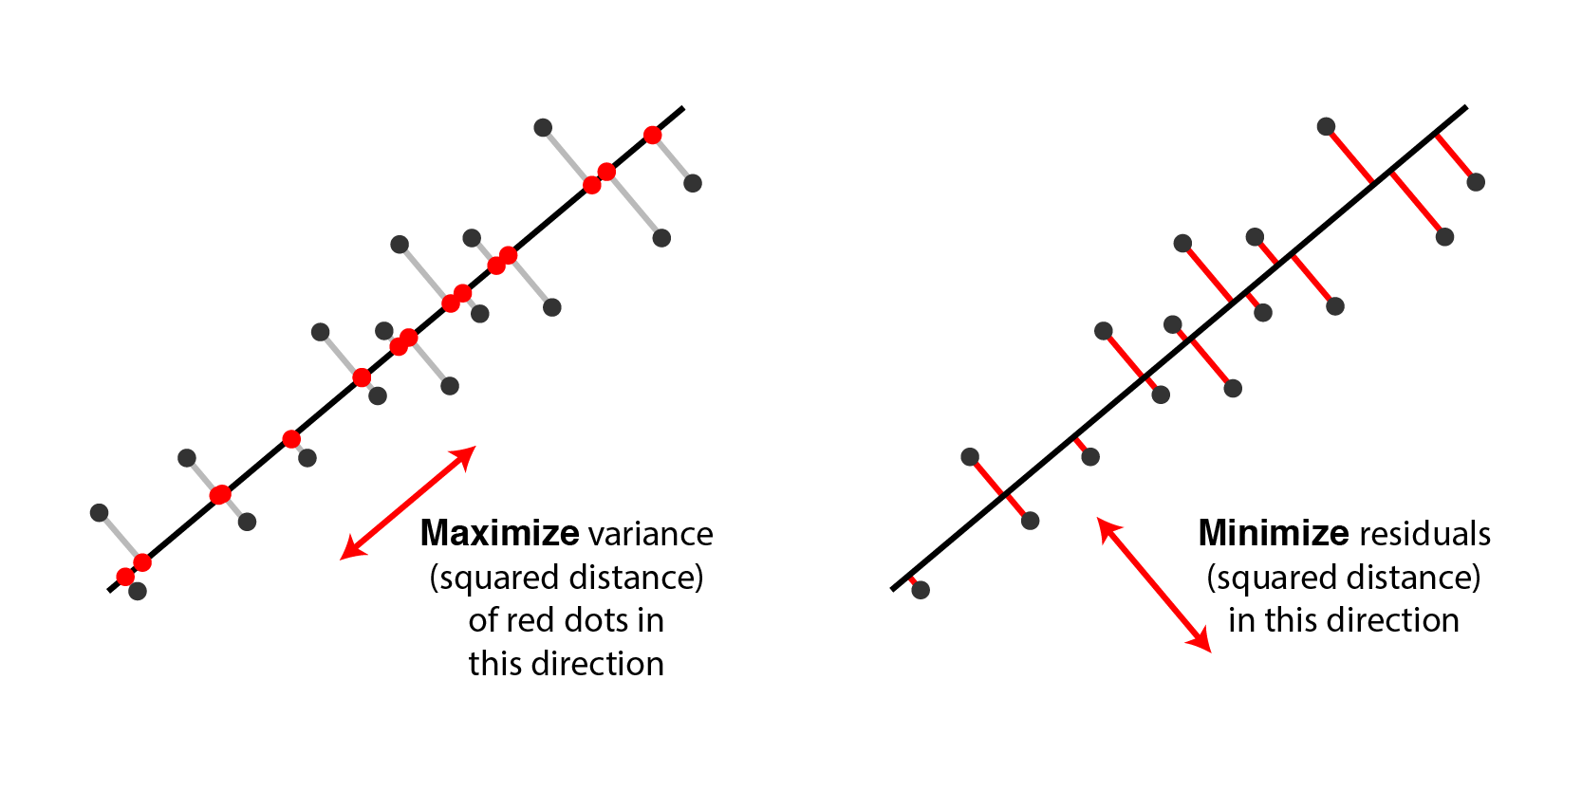
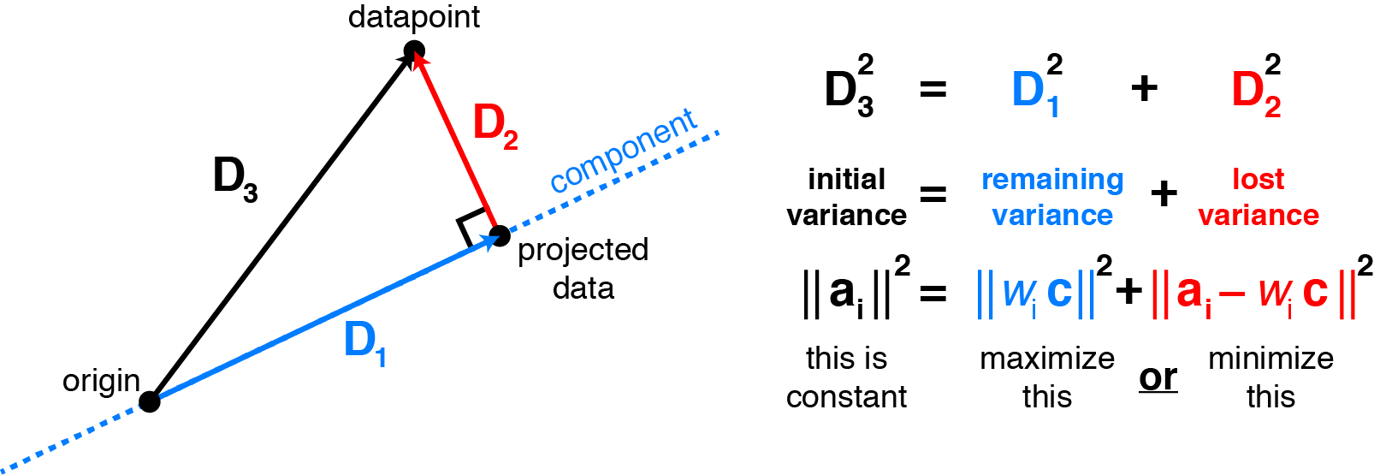
Equivalent Views of PCA
Maximizing variance along a direction is equivalent to minimizing residual errors in this direction.
Everything you did and didn't know about PCA, Alex Williams

Slide 17
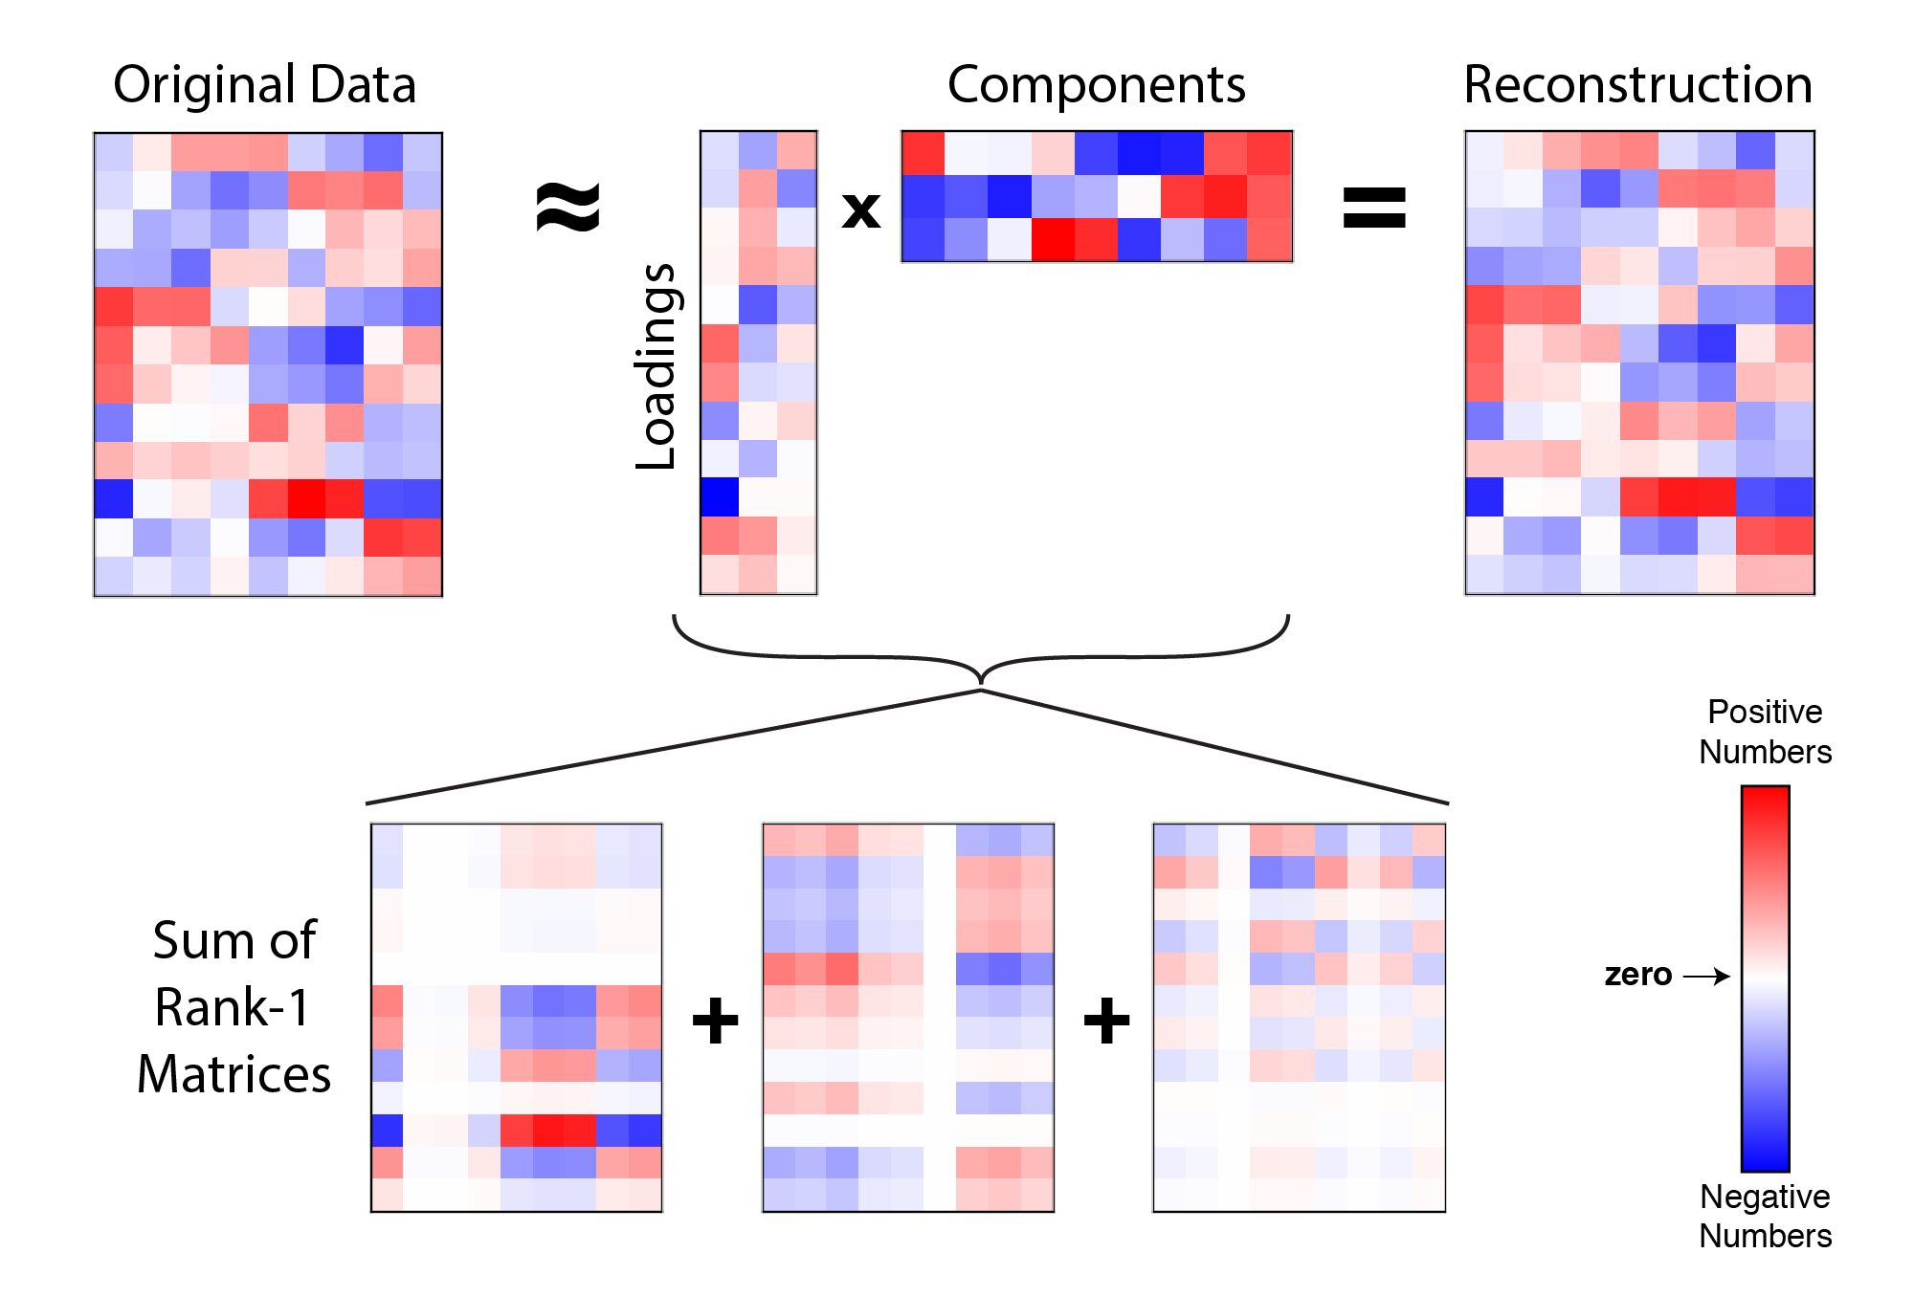
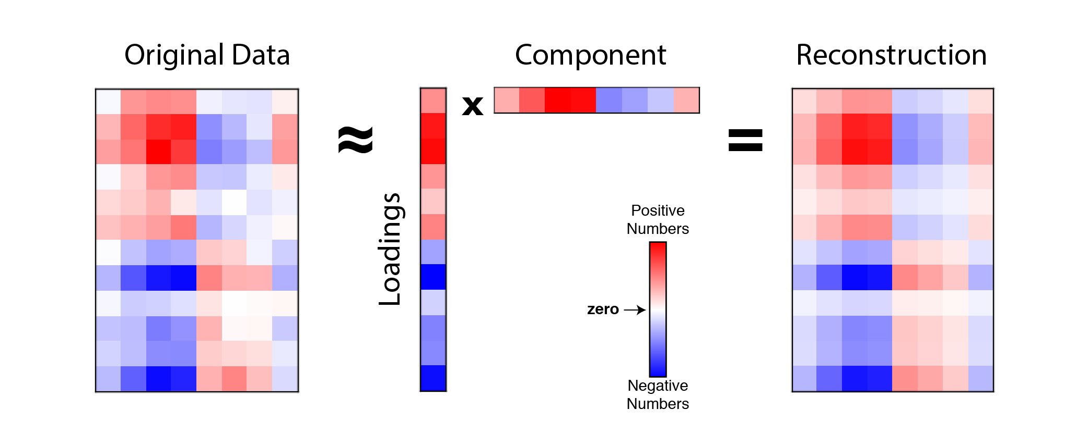
How many dimensions?
What is the optimal dimension?
Too low
Large error
Too high
Inefficiency
Noise

Slide 18
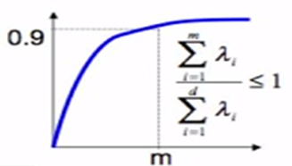
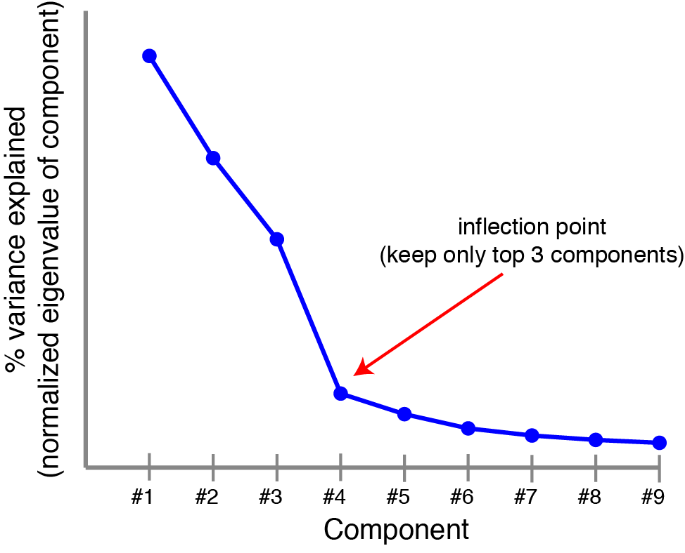

How many dimensions?
Two Methods
Proportion of Variance (PoV)
$$\frac{\sum_{i=1}^{m}{λ_{i}}}{\sum_{i=1}^{d}{λ_{i}}}$$
Typically, threshold is selected to be 0.9, 0.95, or 0.99
Scree Plot
Find the elbow

Slide 19
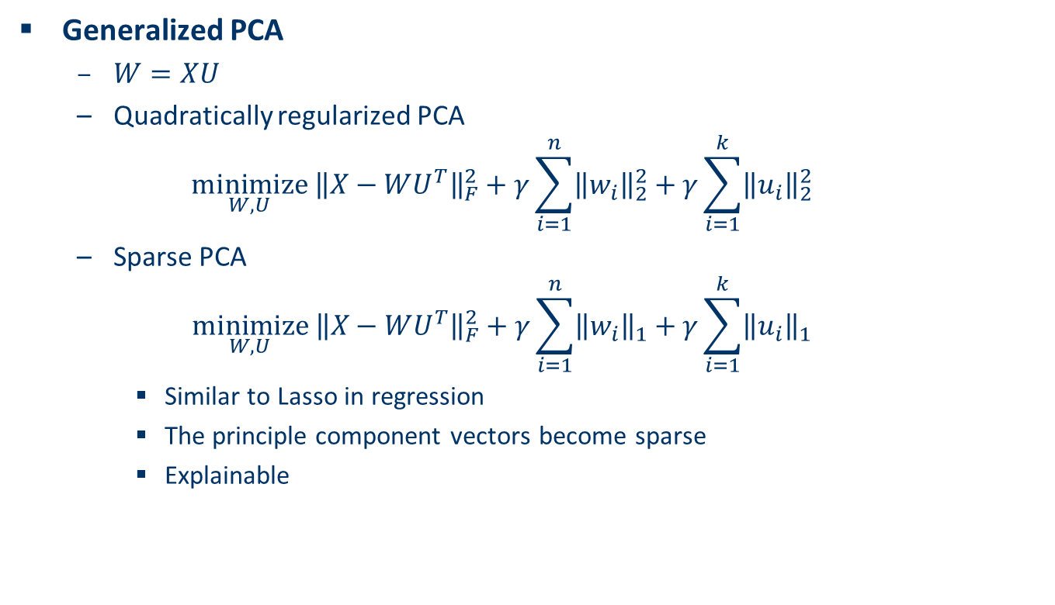
Sparse PCA
Generalized PCA
$W=XU$
Quadratically regularized PCA
$$\underset{W,U}{minimize} {\left\|X−WU^{T}\right\|}_{F}^{2}+γ\sum_{i=1}^{n}{{\left\|w_{i}\right\|}_{2}^{2}}+γ\sum_{i=1}^{k}{{\left\|u_{i}\right\|}_{2}^{2}}$$
Sparse PCA
$$\underset{W,U}{minimize} {\left\|X−WU^{T}\right\|}_{F}^{2}+γ\sum_{i=1}^{n}{{\left\|w_{i}\right\|}_{1}}+γ\sum_{i=1}^{k}{{\left\|u_{i}\right\|}_{1}}$$
Similar to Lasso in regression
The principle component vectors become sparse
Explainable

Slide 20
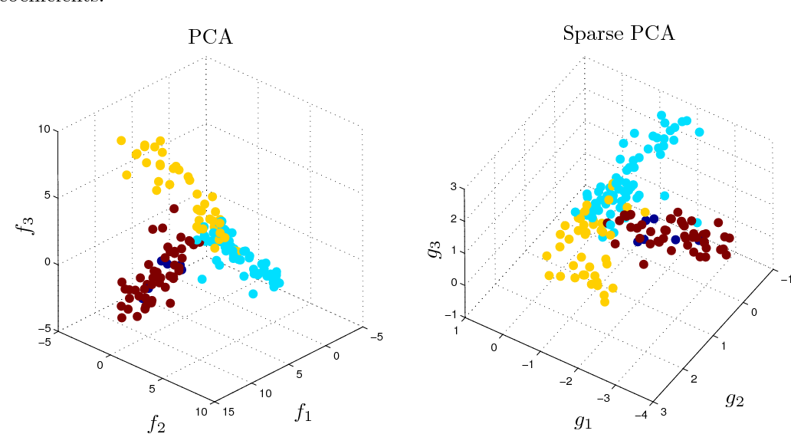
Sparse PCA on Gene Expression Data
All 500 Genes are in principle component vectors.
Only 6, 4, 4 genes show up in the first three principle component vectors.
Both PCA and Sparse PCA show similar clustering patterns.
A Direct Formulation for Sparse PCA Using Semidefinite Programming, Alexandre d'Aspremont, Laurent El Ghaoui, Michael I. Jordan, Gert R. G. Lanckriet, SIAM Review, 2004.

Slide 21
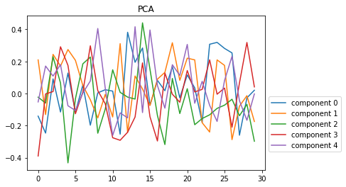
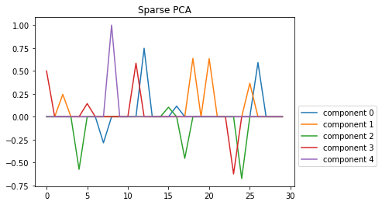
Demo: Sparse PCA
Jupyter Notebook sparsePCA.ipynb

Slide 22
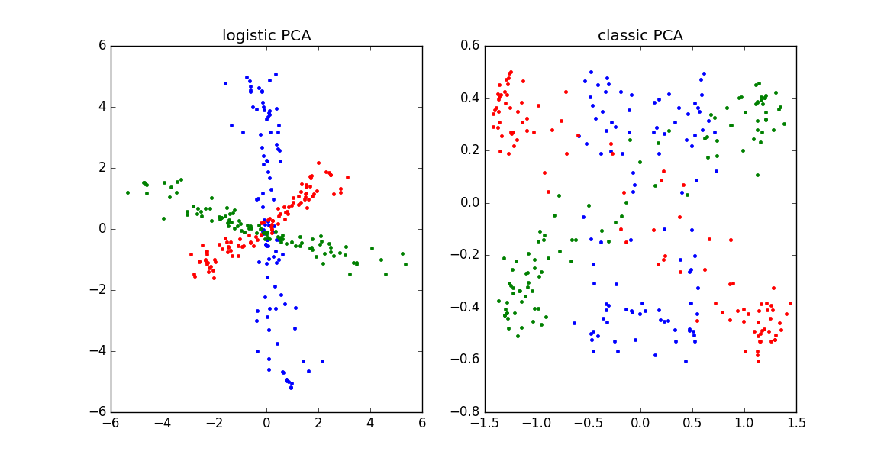

Logistic PCA
Logistic Loss
$\underset{W,U}{minimize} \sum_{i=1}^{m}{\sum_{j=1}^{n}{log(1+exp\left(−x_{ij}\sum_{l=1}^{k}{W_{il}U_{jl}}\right))}}$
Suitable for Binary Data
$x_{ij}=\{−1, +1\}$

Slide 23
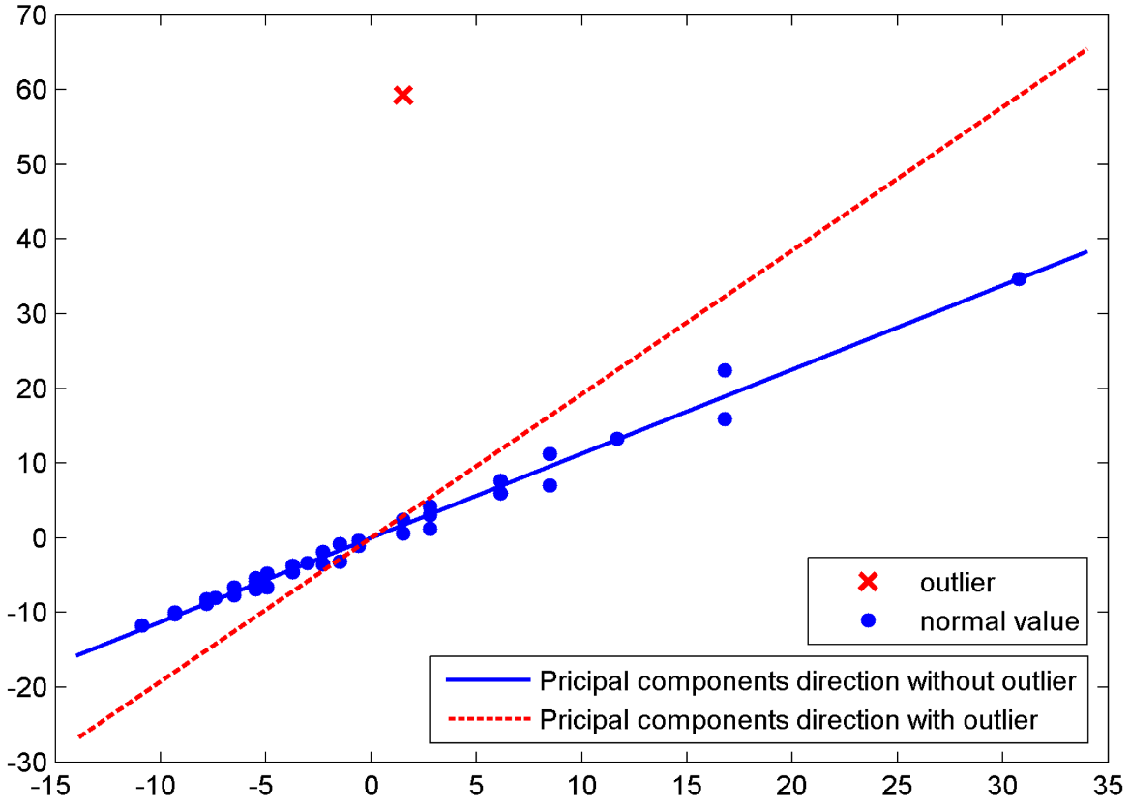
Robust PCA
Robust Against Outliers

Slide 24
Agenda
Introduction to Dimension Reduction
Dimension Reduction Methods
Linear Methods
Principle Component Analysis
Linear Discriminative Analysis
Nonlinear Methods
Kernel PCA
Kernel LDA
ISOMAP
Autoencoder
Applications of Dimension Reduction

Slide 25
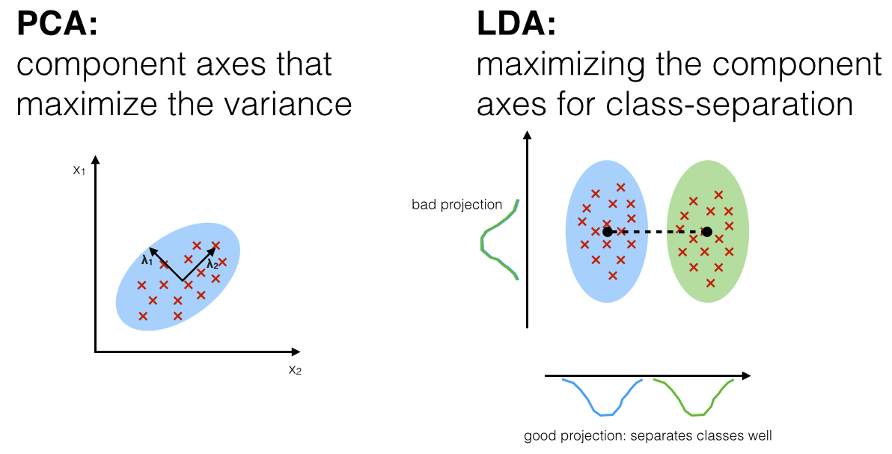
Linear Discriminant Analysis (LDA)
Linear Discriminant Analysis
Fundamental Idea
Pick a new direction that
Maximize separation between means of projected classes
Minimize variance within each projected class
Supervised Learning

Slide 26
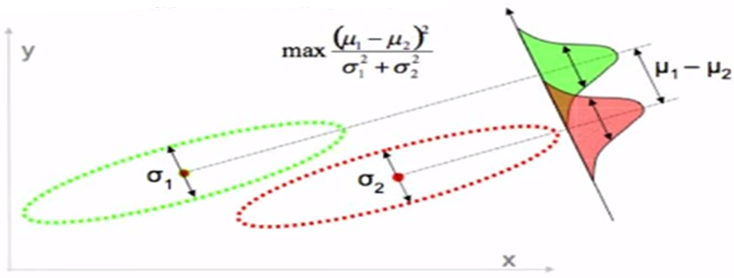
Mathematical Formulation of LDA
LDA
Eigenvectors based on between-class and within-class covariance matrices

Slide 27
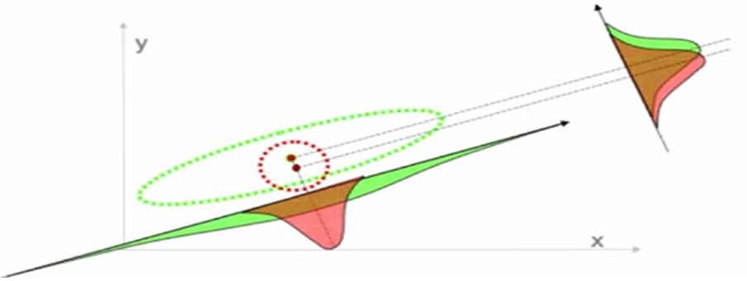
Disadvantages of LDA
Sometimes LDA does not work
Failed when discriminatory information is not in the mean but in the variance of the data
In this example, the difference between the data lies in the variance instead of the mean. PCA does a better job in this case than LDA.

Slide 28
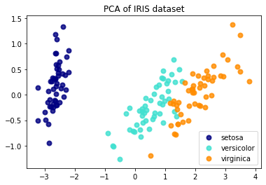
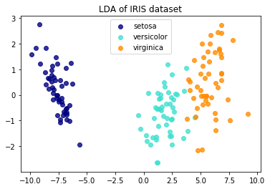
Demo: PCA vs. LDA
Jupyter notebook pca_lda.ipynb

Slide 29
Agenda
Introduction to Dimension Reduction
Dimension Reduction Methods
Linear Methods
Principle Component Analysis
Linear Discriminative Analysis
Nonlinear Methods
Kernel PCA
Kernel LDA
ISOMAP
Autoencoder
Applications of Dimension Reduction

Slide 30
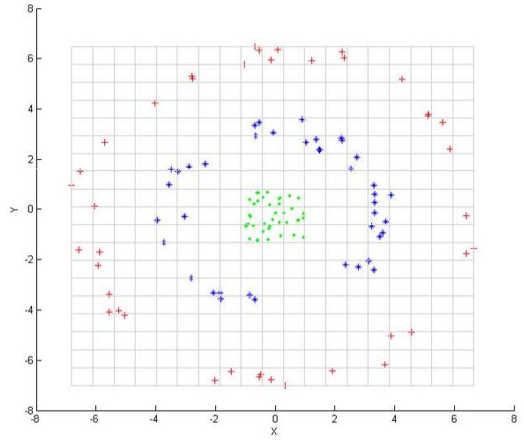
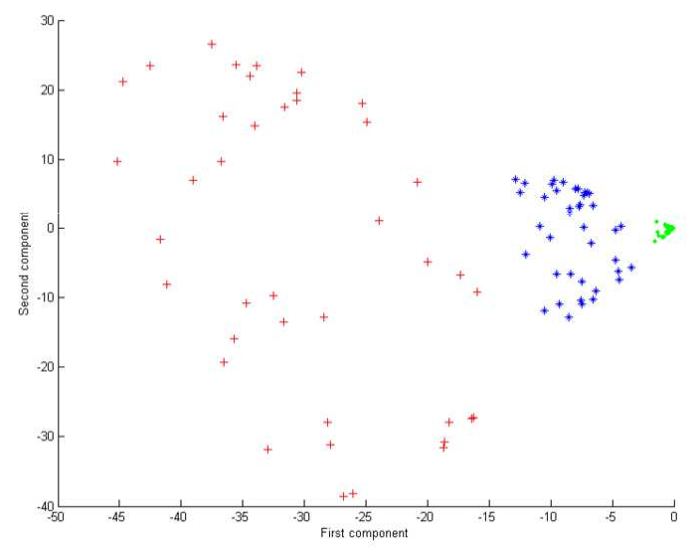
Kernel PCA
Kernel PCA
Re-encoding of the data lying along a non-linear structure
“Kernel Trick”
Manipulate the inner products between all pairs of data in the feature space without explicit computation of the coordinates

Slide 31
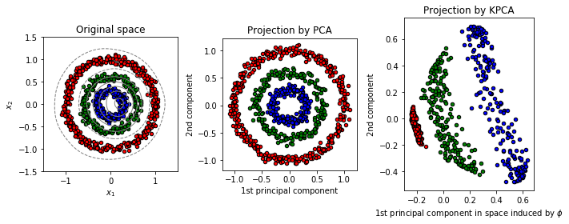
Demo: Kernel PCA vs. PCA
jupyter notebook kernelPCA.ipynb

Slide 32
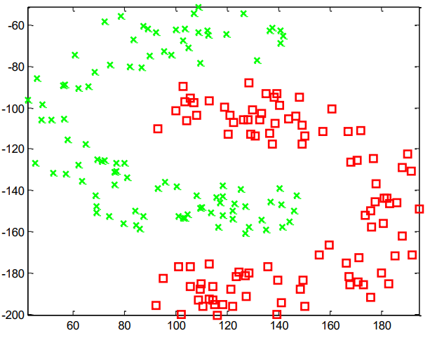
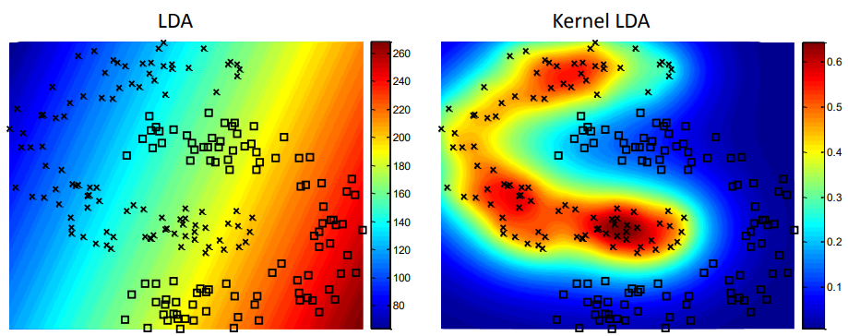
Kernel LDA
Kernel LDA
Applying the “Kernel Trick” to LDA
LDA in non-linear space

Slide 33
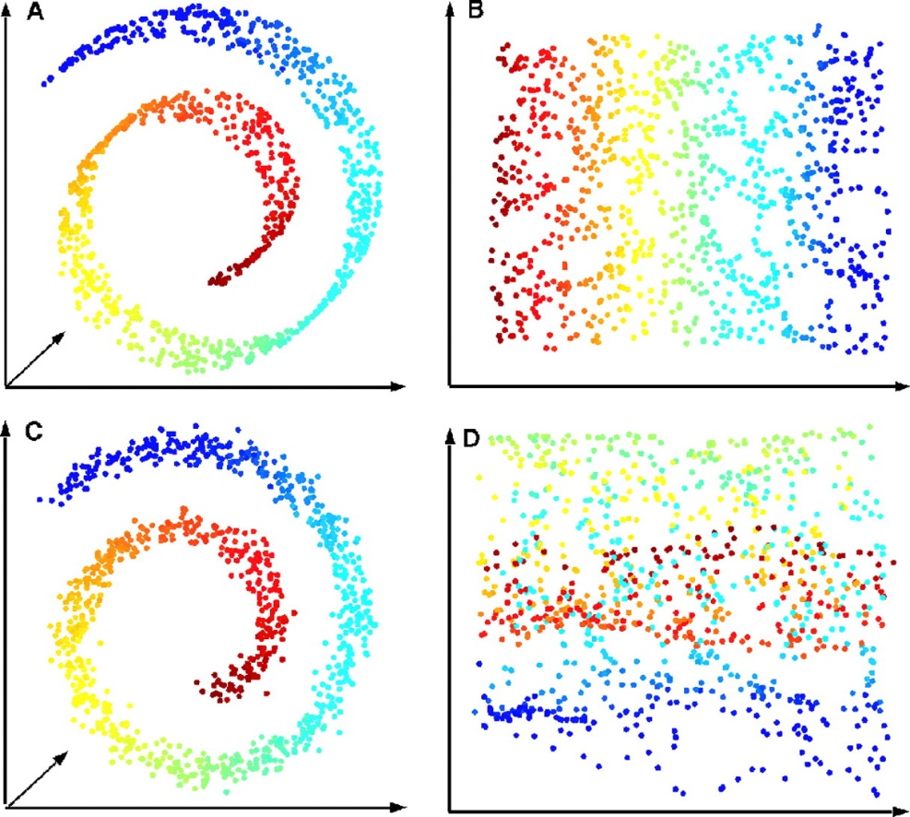
ISOMAP
ISOMAP
Manifold learning
Nonlinear dimensionality reduction
Maintain neighboring datapoints relationship (geodesic distance)

Slide 34
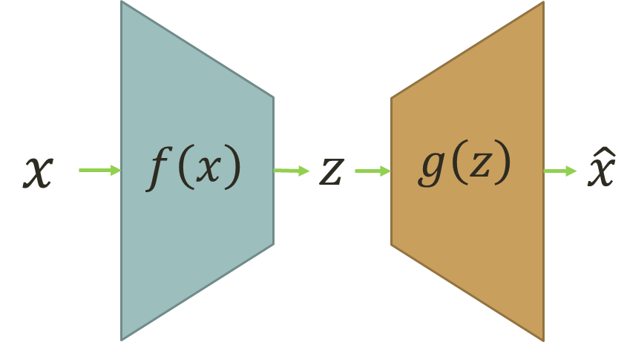
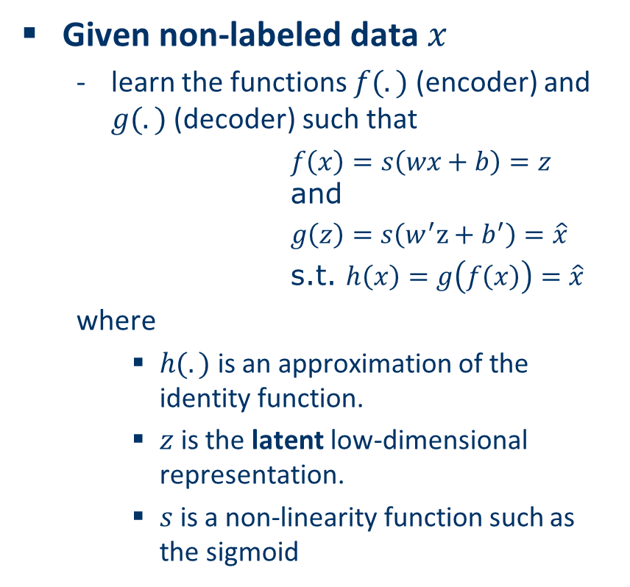
Autoencoder
Given non-labeled data $x$
learn the functions $f(.)$ (encoder) and $g(.)$ (decoder) such that
$f\left(x\right)=s\left(wx+b\right)=z$ and
$g\left(z\right)=s\left(w^{′}z+b^{′}\right)=\hat{x}$
s.t. $h\left(x\right)=g\left(f\left(x\right)\right)=\hat{x}$
where
$h(.)$ is an approximation of the identity function.
$z$ is the latent low-dimensional representation.
$s$ is a non-linearity function such as the sigmoid

Slide 35
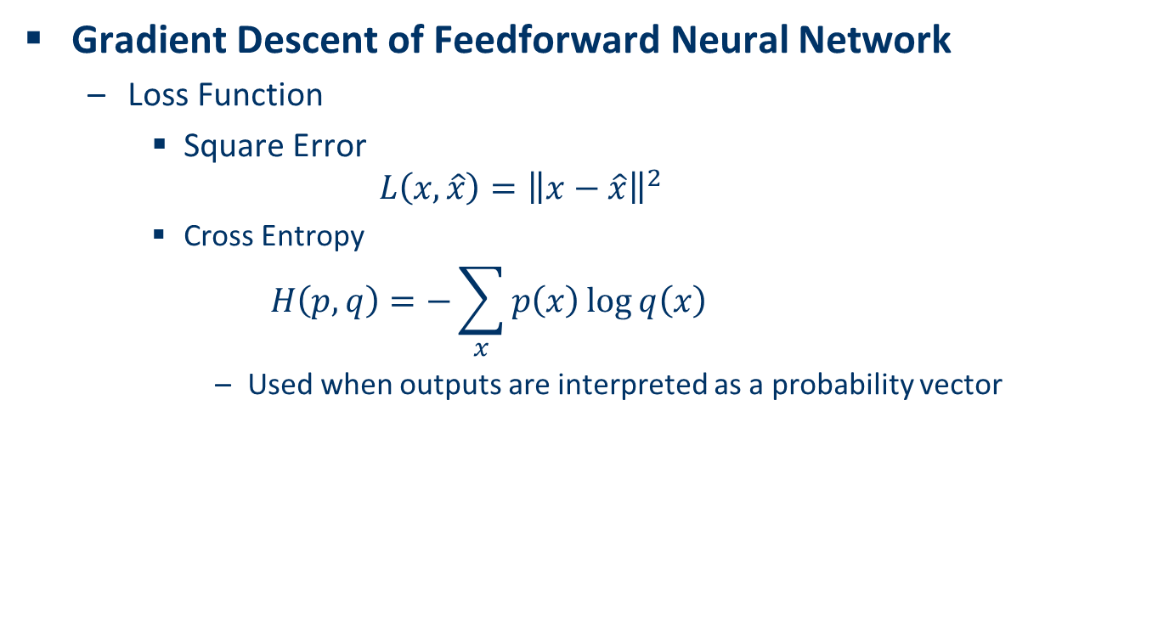
Training of Autoencoder
Gradient Descent of Feedforward Neural Network
Loss Function
Square Error
$$L\left(x,\hat{x}\right)={\left\|x−\hat{x}\right\|}^{2}$$
Cross Entropy
$$H\left(p,q\right)=−\sum_{x}{p\left(x\right)\log{q\left(x\right)}}$$
Used when outputs are interpreted as a probability vector

Slide 36



Denoise Autoencoder
Autoencoder has the ability to remove outliers
Encoder
Decoder
Noisy Input
Denoised Output
Latent space representation

Slide 37
Agenda
Introduction to Dimension Reduction
Dimension Reduction Methods
Linear Methods
Principle Component Analysis
Linear Discriminative Analysis
Nonlinear Methods
Kernel PCA
Kernel LDA
ISOMAP
Autoencoder
Applications of Dimension Reduction

Slide 38
Eigenfaces
Eigenfaces
Standardized face ingredients

Slide 39
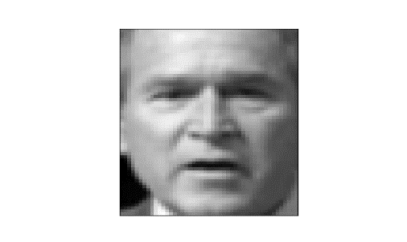
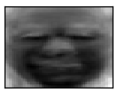

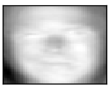
Eigenfaces
=
0.618
+
0.224
+
0.171
+
…
A (any) face can be projected to the eigenface space as face vector
A face vector can be represented as linear combination of eigenfaces
A face is a point in the eigenface space
Classification
Comparison
Generation

Slide 40
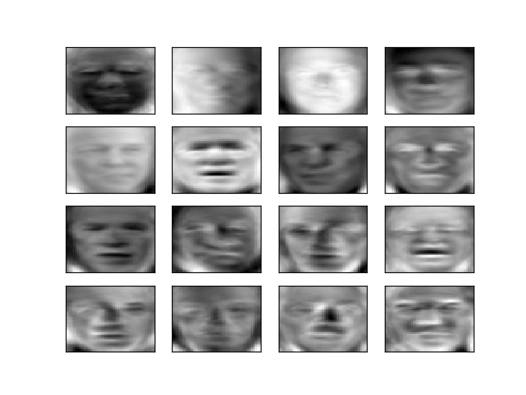
Demo: Eigenfaces
jupyter notebook eigenface.ipynb

Slide 41
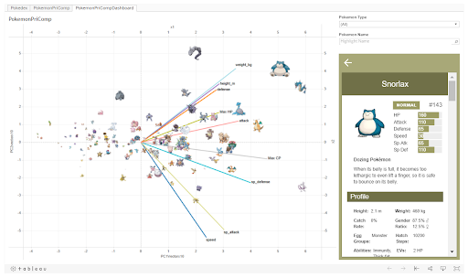
Analysis of Pokemon’s

Slide 42
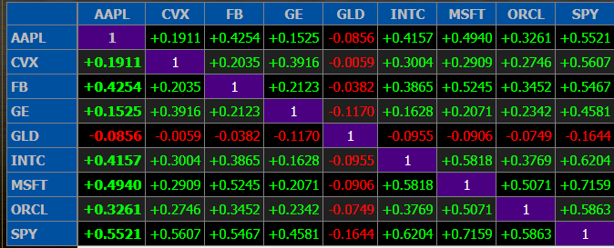
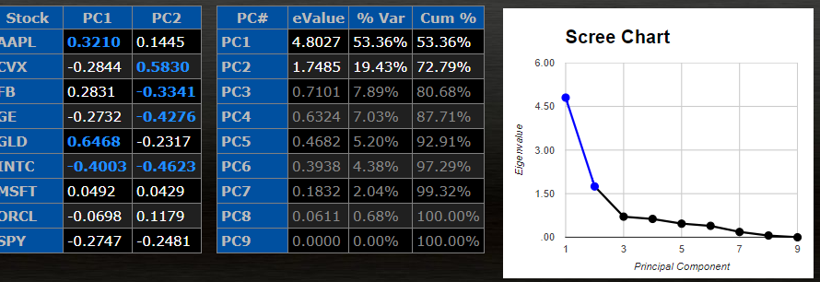
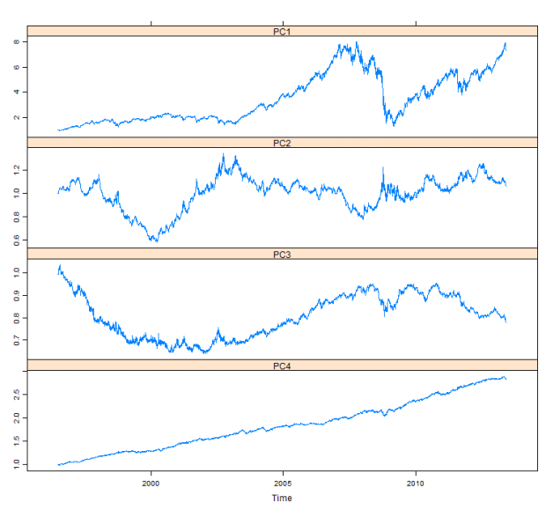
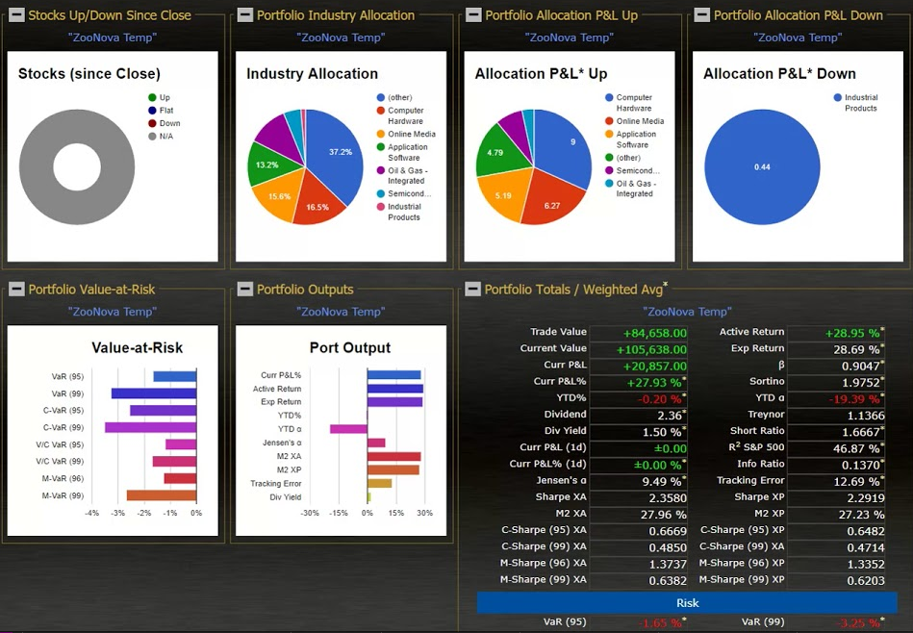
Quantitative Finance

Slide 43
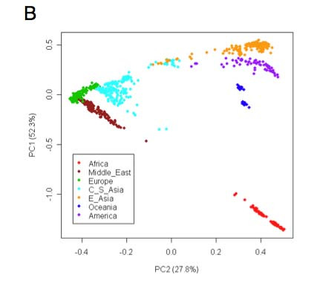
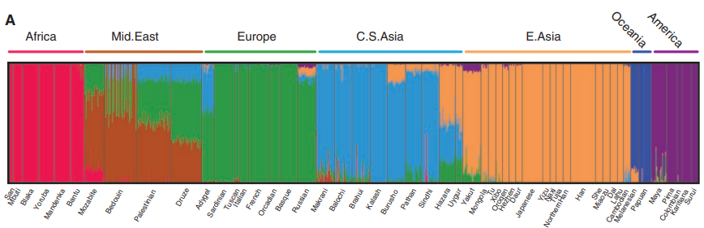
Human Genome
Z. Li et al., Worldwide Human Relationships Inferred from Genome-Wide Patterns of Variation, Science 319: 1100-1104

Slide 44
Advantages and Disadvantages of Dimensionality Reduction
Pros
Dramatic reduction in size of data
Faster data processing
Less storage
Reveal hidden information
Help remove redundant features
Make high-dimensional data visualizable
Cons
Too expensive for many applications
Computation of SVD of large matrix is often the bottleneck
May lose some important information

Slide 45
Summary
Dimension Reduction for Machine Learning
Linear and Nonlinear Dimension Reduction
Advantages and Disadvantages of Dimension Reduction

